Slide 1
#F02U From Zero to Useful Using Ansible with vSphere
By @arielsanchezmor
V1.0

Slide 2
Agenda
A bit about me
From zero to useful series
What’s Ansible and why do I care?
Setting up Ansible on a Linux server
Two ways of talking to vSphere
Playbooks (do the thing!)
Value discussion
Further reading

Slide 3
A favor
Take a pic during this session. Tweet it out with #DVVMUG and #F02U.
I really like interacting with people in Twitter and the #vCommunity – send me any questions you think of!

Slide 4
A bit about me
Costa Rican, currently living in Pittsburgh
Resume stuff
Big proponent of the vCommunity (vBrownBag, vExpert, VMUG, VTUG, vBeers, vBrisket, etc)
E-470 & Smoky Hill Rd, near Southlands Mall
My journey started with a book: Scott Lowe's Mastering vSphere 5
VCP! YEAHH

Slide 5
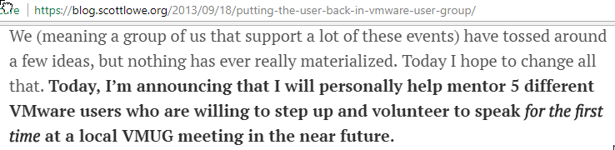

Denver changed my career
blog.scottlowe.org
Thanks to Scott, for everything
I spoke at my first VMUG!
I started using Twitter
I want to pay that forward today

Slide 6
From Zero To Useful series
Started these in vBrownBag.com with vRops
“Teach me like I’m a noob”
Session should be _practical_
There are no dumb questions
*The one eyed leading the blind*
*Stand on the shoulders of giants*
#F02U is the twitter hashtag ;)

Slide 7
This is an interactive session
I left some time so we can do practical things, test different things.
CentOS VM running Ansible, a host/VCSA on 6.5, and a host/VCSA on 6.7
If you already have a test VCSA and are running Linux/Mac on your laptop you can probably follow along, I did it in Workstation
I’m no expert, but we can all figure stuff out, it’s how we make our livelihoods lol

Slide 8
What’s Ansible and why do I care
Ansible is open source software
Very flexible
Minimum requirements (no agents to deploy)
Allows one-time changes or declarative infrastructure management
Enables infrastructure as code
Uses YAML which is very readable

Slide 9
I do mean flexible
Ansible is an infrastructure management tool
It can interface with about everything with an API, or SSH!
Uses modules to interface
Lots of abstraction – what you do is really the minimum
Allows net/sys/devs/etc to collaborate

Slide 10

New tool in your toolset
shoutout @lauriepcapo for the meme!

Slide 11
Ansible in a nutshell
Ansible-playbook cmd executes a playbook
A playbook is just a yml file (text)
Playbooks define tasks in code “plays”
Tasks leverage modules to change inventory
Inventory can be in a file or gathered
Researching modules is probably the most time intensive task
Apart from troubleshooting ☺

Slide 12
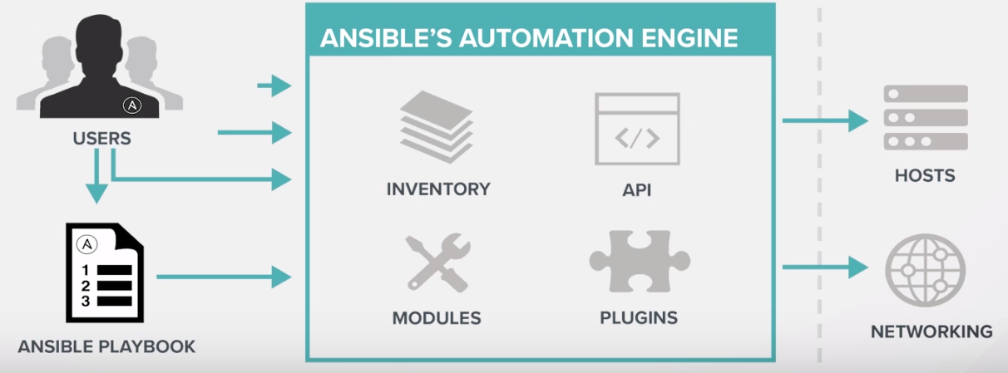
Show me a diagram
Awesome intro video by Red Hat

Slide 13
Setting up Ansible on a Linux server
I’m using CentOS but you can use about any *nix
Do recommend installing through pip, makes sure python, ansible and pyvmomi are in compatible versions (whaaat?)
This is the way I found it to “just work”
You could also just do “sudo yum install ansible” to test without python (latest is 2.5)

Slide 14
Let’s prepare a Linux VM
CentOS 7 VM, 1 vCPU, 1GB RAM, IP address
Minimal install, set a separate admin user
Get accustomed to not using root (logging in production)
Make sure you can reach internet
Yum update to patch the OS to latest
SSH in through PuTTY

Slide 15
All installation commands
sudo yum update
sudo yum install python-setuptools
sudo easy_install pip
sudo pip install pyvmomi
sudo pip install ansible
That’s it!

Slide 16
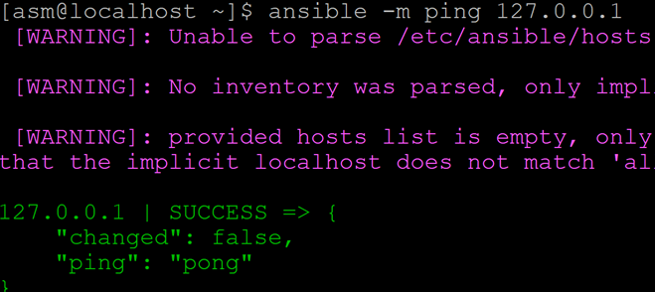
Your first Ansible command
Use the ping module to test “pinging the localhost” – get pong ☺
ansible –m ping 127.0.0.1

Slide 17
Check versions
Check your ansible, python, pyvmomi versions
[asm@localhost ~]$ pip show pyvmomi
Name: pyvmomi
Version: 6.7.0
Summary: VMware vSphere Python SDK
Home-page: https://github.com/vmware/pyvmomi

Slide 18
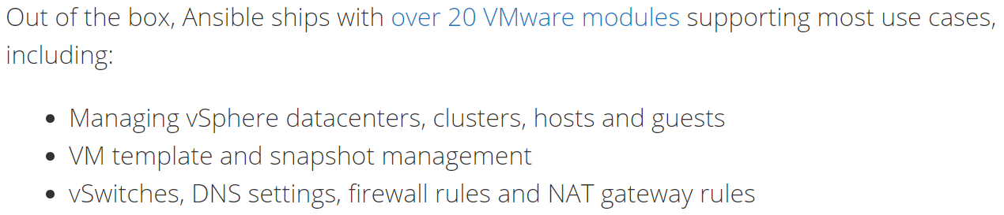
Two ways of talking to vSphere
Traditional (ansible.com) is using modules that rely on pyvmomi (python)
http://docs.ansible.com/ansible/latest/modules/list_of_cloud_modules.html#vmware
- Let’s go take a look!

Slide 19
Ansible and VMware REST
Available since 6.5 and 6.7 is using the URI module to talk to a REST API
Literally, all the module does is allow you to make HTTP calls
- HTTP calls are GET, POST, PUT, DELETE, etc
- HTML responde codes (200 is good)
VMware includes a cool way to explore it

Slide 20
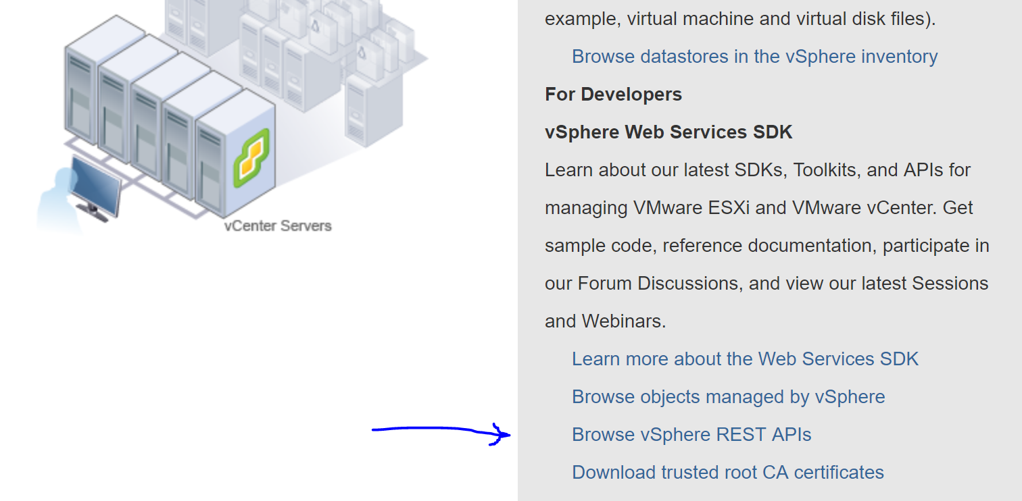
REST is easy
https://[[VC IP Address or FQDN]]/apiexplorer
Kyle Ruddy did an excellent vBrownBag video

Slide 21
REST changes
6.7 has lots more to offer than 6.5, but you still won’t find everything
Let’s quickly check William Lam’s blog
VMware is definitely aware but they need customers to complain ☺

Slide 22
Playbooks (do the thing!)
Let’s see an example by @CarlCapozza
You can see a video of his full VMUG presentation here
Also his original ppt and files here
I literally stole his slides ☺
Remember, in open source, you take advantage
These files are already in the CentOS VM so we can play with it

Slide 23
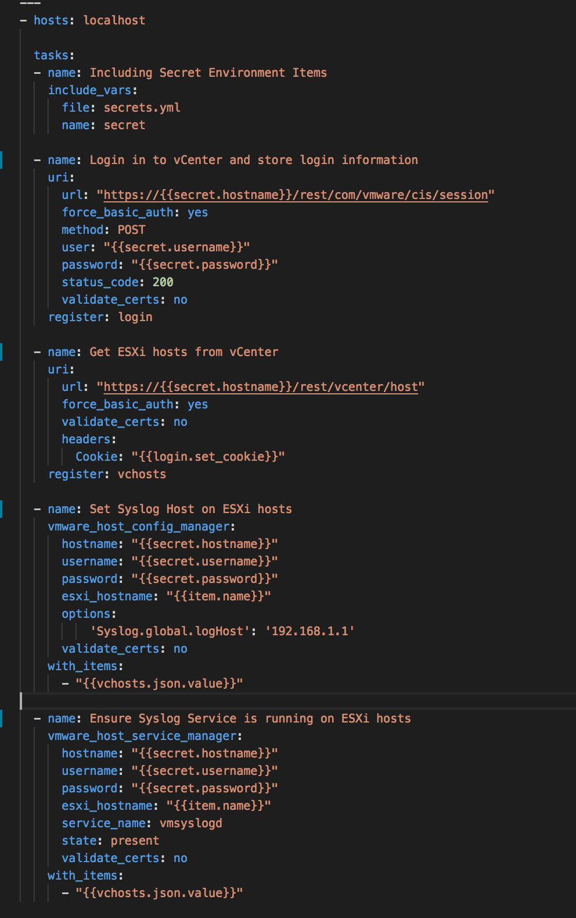

Example of using Ansible with vSphere
Research:
vSphere API
Write Code:
Tasks
Login
Get hosts
Set Syslog host
Ensure Syslog is running
Login
Get Hosts
Set Syslog
Ensure running

Slide 24
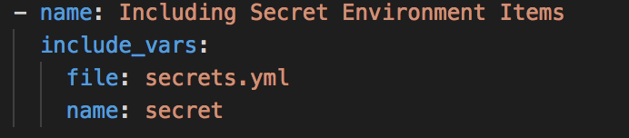
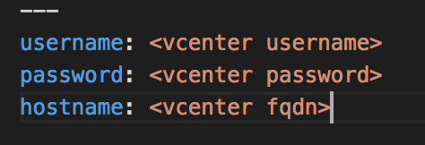
Login Credentials Management
Importing variables from a file
include_vars: (Module)
name: (Save these for later)
Separate secrets.yml file
Notes:
All of these are in the same file.

Slide 25
Example of using Ansible with vSphere
Research:
vSphere API
Write Code:
Tasks
Login
Get hosts
Set Syslog host
Ensure Syslog is running
Login
Get Hosts
Set Syslog
Ensure running

Slide 26
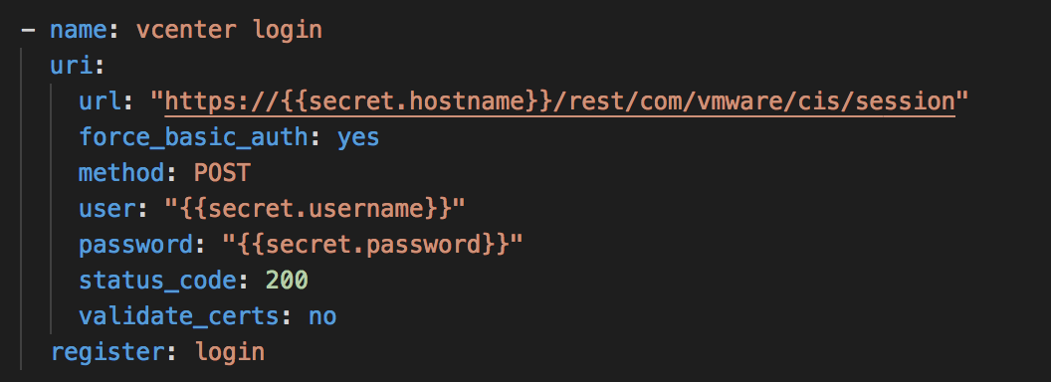
API Authentication
Ansible URI Module
hostname, user, and password are variables
register: (save the response information as login)

Slide 27
Example of using Ansible with vSphere
Research:
vSphere API
Write Code:
Tasks
Login
Get hosts
Set Syslog host
Ensure Syslog is running
Login
Get Hosts
Set Syslog
Ensure running

Slide 28
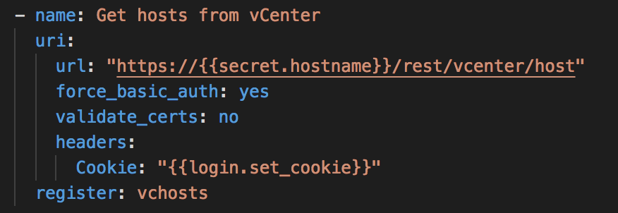
Get all the hosts in vCenter
Ansible URI module
JSON values returned

Slide 29
Example of using Ansible with vSphere
Research:
vSphere API
Write Code:
Tasks
Login
Get hosts
Set Syslog host
Ensure Syslog is running
Login
Get Hosts
Set Syslog
Ensure running

Slide 30
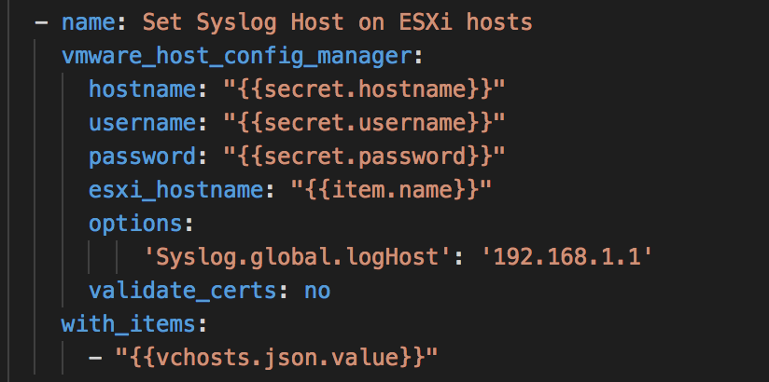
Set Syslog Host
Ansible Plugin (pyVmomi)
with_items: run the above on all values
{{item.name}} is variable containing each the esxi host name

Slide 31
Example of using Ansible with vSphere
Research:
vSphere API
Write Code:
Tasks
Login
Get hosts
Set Syslog
Ensure Syslog is running
Login
Get Hosts
Set Syslog
Ensure running

Slide 32
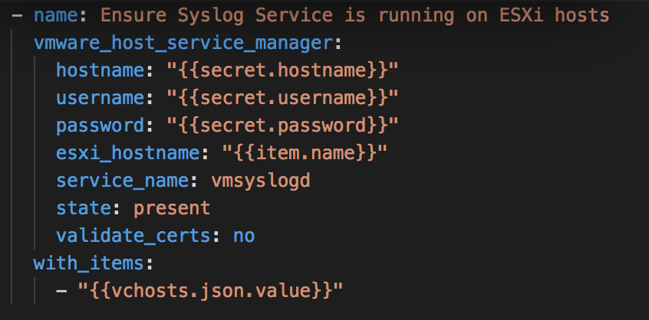
Ensure Syslog Service is running
Ansible Plugin (pyVmomi)

Slide 33
Example of using Ansible with vSphere
Research:
vSphere API
Write Code:
Tasks
Login
Get hosts
Set Syslog
Ensure Syslog is running
Login
Get Hosts
Set Syslog
Ensure running

Slide 34
Ensure Syslog Service is running
Ansible Plugin (pyVmomi)

Slide 35
Example of using Ansible with vSphere
Research:
vSphere API
Write Code:
Tasks
Login
Get hosts
Set Syslog
Ensure Syslog is running
Login
Get Hosts
Set Syslog
Ensure running

Slide 36
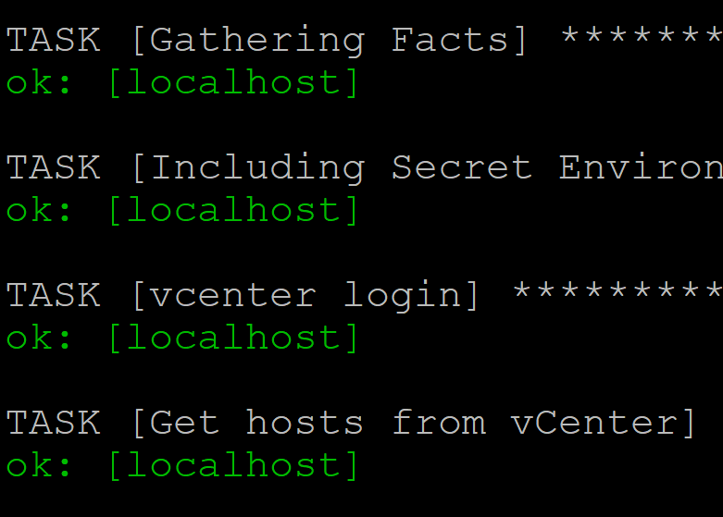
You should see green & a report

Slide 37
Awesome, let’s actually do
I have the files in Atom here on my PC
WinSCP them to the CentOS VM, or edit with vi
Run em ☺
ansible-playbook auth-gatherhosts-api-py-65.yml
ansible-playbook auth-gatherhosts-api-py-67.yml

Slide 38
Value discussion
PowerCLI can probably do more than this
There’s several ways to do this today
Could this be your first API tool?
OS management – More Linux than Windows
Cisco equipment – video by @petes_revenge
You can actually get real support with more features from RedHat
But most python modules have no warranty

Slide 39
Further Reading
Official Ansible documentation here
Follow and read their code:
- @jfrappier twitter GitHub
- @mrlesmithjr twitter GitHub
- @carlcapozza twitter GitHub
Blog series by @dkalaluhi “Ansible for mere mortals”
VTUG ppt on this by Jfrap and Kyle Ruddy

Slide 40
We’re done ☺
Let’s get to trying things with the time we have!
Give feedback in the tool, and give feedback to me ☺

